Slide 1
Professor Lesley Yellowlees
The Queen’s Nursing Institute Scotland

Slide 2
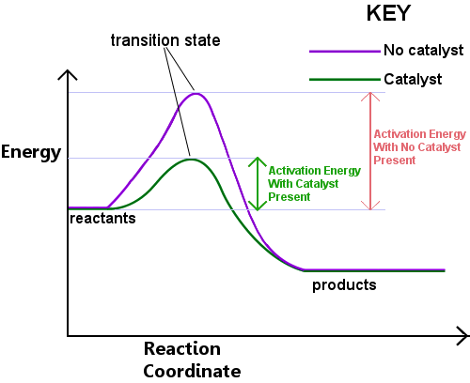
Catalyst: What is it?
A catalyst is a substance that speeds up a chemical reaction, but is not consumed by the reaction; hence a catalyst can be recovered chemically unchanged at the end of the reaction it has been used to speed up, or catalyze.

Slide 3
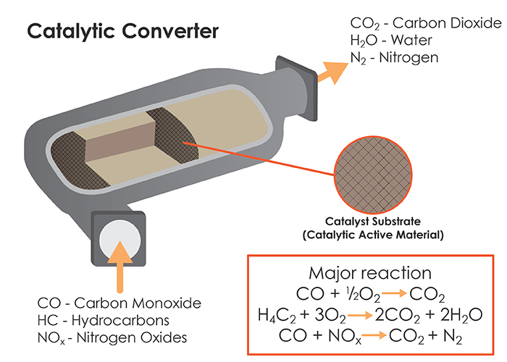
Examples of Chemical Catalysts
Heterogeneous Catalysis
Haber Process:
N_{2 (gas)} + 3H_{2 (gas)} ⇌ 2NH_{3 (gas)}
Catalyst: Iron Fe
Catalyst: Pt

Slide 4
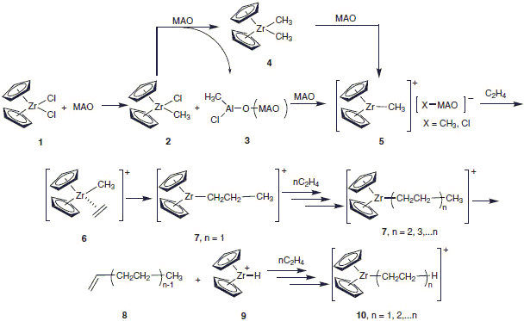
Examples of Chemical Catalysts
Homogeneous Catalysis
Ziegler-Natta – formation of plastics

Slide 5
Example of Biology Catalyst: Enzyme

Slide 6
Demonstration
Elephants Toothpaste
Reactant (starting material): hydrogen peroxide H₂O₂
Products (final materials): water (H₂O) and oxygen (O₂)
Catalyst: potassium iodide (KI)
Overall reaction: 2H₂O₂ → 2H₂O + O₂

Slide 7
Catalysts: never used up during a reaction
can be reused many, many times for the same reaction
are different for different reactions

Slide 8
Catalysts – Agents for change
Govan Men’s Shed
Mature Walks for Wellbeing
Breast-feeding and early nutrition
Supportive Self-Management
Tweeddale informal carers’ well-being
The Three Bridges
Get moving!

Slide 9
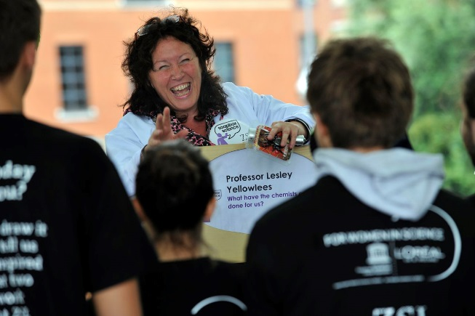
Agent for Change
Early 1990’s : Outreach

Slide 10
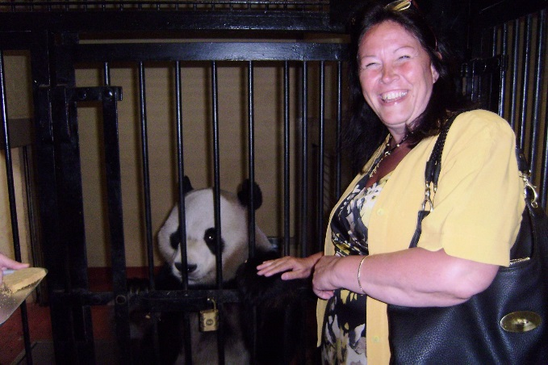
Agent for Change
2004 : Athena Swan

Slide 11
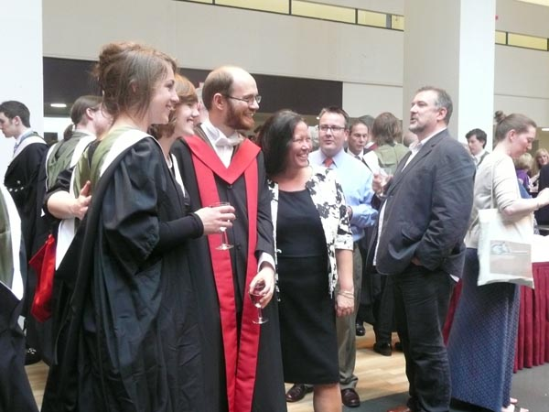
Agent for Change
2007: Head of Chemistry

Slide 12
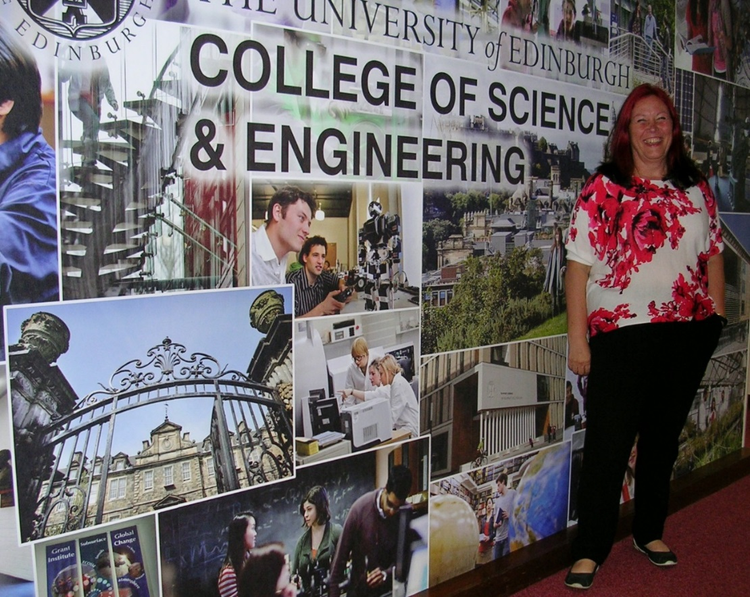
Agent for Change
2011 : Vice Principal and Head of the College of Science and Engineering

Slide 13
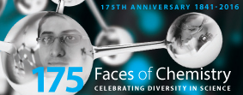
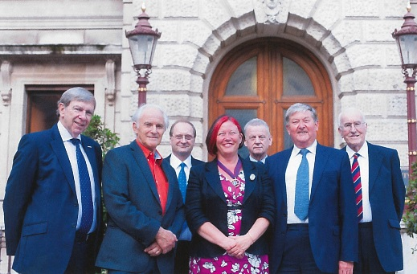
Agent for Change
2012 : President of the Royal Society of Chemistry

Slide 14
Demonstration
Reactants (starting materials): Hydrogen (H₂) and Oxygen (O₂)
Product (final material): water (H₂O)
Catalyst: Carbon Black (Pd on C)
Overall reaction: 2H₂ + O₂ → 2H₂O

Slide 15
Chemical Catalysts
Need to find right catalyst for reaction
Catalysts are expensive eg Pd, Pt
Catalysts often need support
Catalysts need looking after – easily ‘poisoned’
Catalysts are valuable
………….Community Catalysts

