Slide 1
Rhona Hotchkiss Governor HMP Greenock Linda Semple Head of Sustainability and Value, NHSScotland | Risk and You QNIS March 2018
UNLOCKING POTENTIAL
UNLOCKING POTENTIAL
TRANSFORMING LIVES

Slide 2
Risk and You
Why Did You Get Up Today

Slide 3
Risk and You
What does the word ‘Risk’ make you think of?

Slide 4
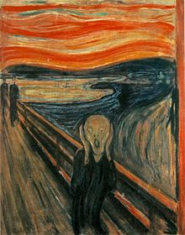

Slide 5
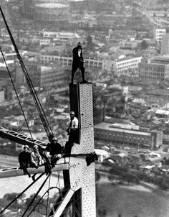

Slide 6
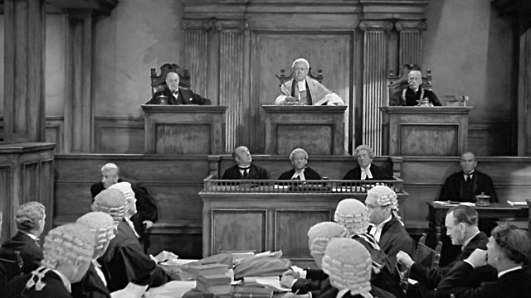

Slide 9
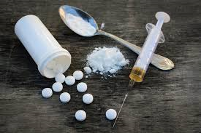

Slide 10
Risk and you
We all face it every day
We do things – get up , drive, etc., because the benefits and their likelihood outweigh the risk
Is that ever not true?

Slide 11
Risk and You. What is Risk?
“Risk generally refers to the possibility of loss or costs when an outcome is uncertain, but in clinical and criminal justice settings, it means the chance of an adverse outcome”.
(Blackburn 200)

Slide 12
Risk and You – What is Risk? Will You Face It?
Do you work with people?
Are they all individuals?
Do they have free will?
Can everything you do be turned into a protocol?
Will you ever face situations you’ve never faced before?
Do things always turn out the way you planned?
“Risk is a course of action – or inaction – taken in conditions of uncertainty” (Kindler 1990)

Slide 13
Risk and You. What Makes Risk Decisions Difficult?
Your patients are always autonomous (or having someone working in their interest)
On occasion the right of others not to be harmed takes precedence
We live in a blame culture
It sometimes involved a dilemma (lesser of two evils…)

Slide 14
Risk and You. Why Take a Risk – and Why Not?

Slide 15
Risk and You. The Benefits and Dis-benefits
Finance
Paternalism
Restrictive practice
Learning/No learning
Innovation/Status Quo
Do good/miss the opportunity to do good
Personal and Professional

Slide 16
Risk and You. Some Legal Implications
You must owe people a duty of care
You must have broken a standard that applies under that duty
Your breach of that standard must have caused harm
You must have acted in a way that no responsible person in your profession would have acted

Slide 17
Risk and You. Strategies to Manage Risk
Is there a protocol?
Can other people help me with the information?
Can I set any aspect of this aside for now?
Has someone else done this before?

Slide 18
Risk and You. Realistic Medicine - sharing the risk
Is this test, treatment or procedure really needed?
What are the benefits and what are the downsides?
What are the possible side effects?
Are there simpler or safer options?
What would happen if I did nothing?

Slide 19
Risk and You. After The Fact
At the time – thoughts, considerations, decisions
Does a good outcome mean it was a good decision?
Does a poor outcome mean it was a poor decision?

Slide 20
Risk and Me. 3 Personal Parameters
B
B
B

